Slide 1






EL NUEVO ARTE
DE VIVIR
FILOSOFÍA DE
10% · 3 REGLAS · 3 METAS
KIDS IUL

Slide 2
ANTES DE PLANEAR EL FUTURO DE SUS HIJOS
CONSIDERe lo SIGUIENTE
Aumento de los costos de educación y vivienda
Impuestos e inflación que afectan los ahorros
La mayoría de las familias comienzan demasiado tarde, perdiendo años de crecimiento compuesto
¿Por qué empezar pronto?
Haga más que solo planear para la universidad
Más años de crecimiento libre de impuestos
Valor del dinero en el tiempo: pequeñas cantidades crecen exponencialmente

Slide 3

¿CUÁNTO LE COSTARÁ?
Número de años hasta la universidad | Costo estimado de matrícula de 4 años*
 | Pública (en el estado) | Pública (fuera del estado) | Privada
1 (2022) | $46,647 | $138,215 | $163,503
2 | $48,979 | $145,126 | $171,678
3 | $51,428 | $152,382 | $180,262
4 | $54,000 | $160,001 | $189,275
5 | $56,700 | $168,001 | $198,739
6 | $59,535 | $176,401 | $208,675
7 | $62,511 | $185,221 | $219,109
8 | $65,637 | $194,482 | $230,065
9 | $68,919 | $204,206 | $241,568
10 | $72,365 | $214,417 | $253,646
11 | $75,983 | $225,137 | $266,329
12 | $79,782 | $236,394 | $279,645
13 | $83,771 | $248,214 | $293,627
14 | $87,960 | $260,625 | $308,309
15 | $92,358 | $273,656 | $323,724
16 | $96,976 | $287,339 | $339,910
17 | $101,824 | $301,706 | $356,906
18 | $106,916 | $316,791 | $374,751
19 | $112,261 | $332,631 | $393,489
20 | $117,874 | $349,262 | $413,163
* Projected costs estimated base on data from the National Center for Education Statistics with a conservative 5% increase.
National Center for Education Statistics – Digest of Education Statistics. https://nces.ed.gov/programs/digest/d20/tables/dt20_330.10.asp?current=yes. Accessed 05 May 2021.
Notes:
Now let’s look more into the Wealth Formula. In the next few sections we’ll be talking about Rate of Return, Inflation and Taxes, and how they can all impact our wealth.
(read slide)
By using the Rule of 72, we can calculate how much an initial principal of $10,000 changes with different interest rates.
By dividing 72 by the rate of return (or interest), equals to the approximate number of years it takes for the money to double.
Note that numbers here are actual values compounded annually. This an example to illustrate a concept and does not represent any specific product.
For example, imagine saving $10,000 in a place with an interest of 6%.
Using the Rule of 72, 72 divided by 6 equals 12, thus every 12 years the money would “double”.
12 years from now, that money would “double” to $20,112.
24 years from now, “double” to $40,489.
36 years from now, “double” to $81,472.
If in a place that grows at 8%, that same $10,000, would now double every 9 years.
From $19,990, 9 years from now, to $39,960 18 years from now.
And 27 years from now, grow to be $79,881.
36 years from now, $159,682.
If in a place that grows at 10%, that same $10,000, would now double every 7.2 years.
7 years from now, ”double” to $19,487.
15 years from now, $41,772.
22 years from now, $81,403.
29 years from now, $158,631.
And finally 36 years from now, $309,126.
So you can see how easy it is to roughly calculate compound interest using the Rule of 72.
Additionally, take a look at year 36, you can see the difference 2% and time makes. The difference between 6% and 8% is two percent, however the resulting amount at age 36 is nearly twice the amount. Also as with 8% and 10%.
Let’s look at an example: if you save $100 and put it into a place that gave you 5% interest, you would have an interest of $5.
Presuming an effective 25% income tax, it would reduce your total by $1.25 giving you a net total of $103.75.
After factoring in inflation (using an average of 3%), you would have an actual return of $100.75. What does this mean?
Do you need around 5% interest to break even on your money? It’s important to understand the real rate of return.

Slide 4
CUÁNTO NECESITA AHORRAR
¿Ahorrar $50 - $100 / al mes es suficiente?
Si tiene 18 años para ahorrar para una escuela que cuesta $106,916 (pública, residente del estado, dentro de 18 años), necesitará ahorrar:
TASA DE RENDIMIENTO | CONTRIBUCIÓN MENSUAL
2%
5%
8%
$416.10
$316.70
$237.91
¿Está obteniendo el máximo provecho de donde está invirtiendo?
U.S. Securities & Exchange Commission – Savings Goal Calculator (Compounded Annually). https://www.investor.gov/additional-resources/free-financial-planning-tools/savings-goal-calculator

Slide 5
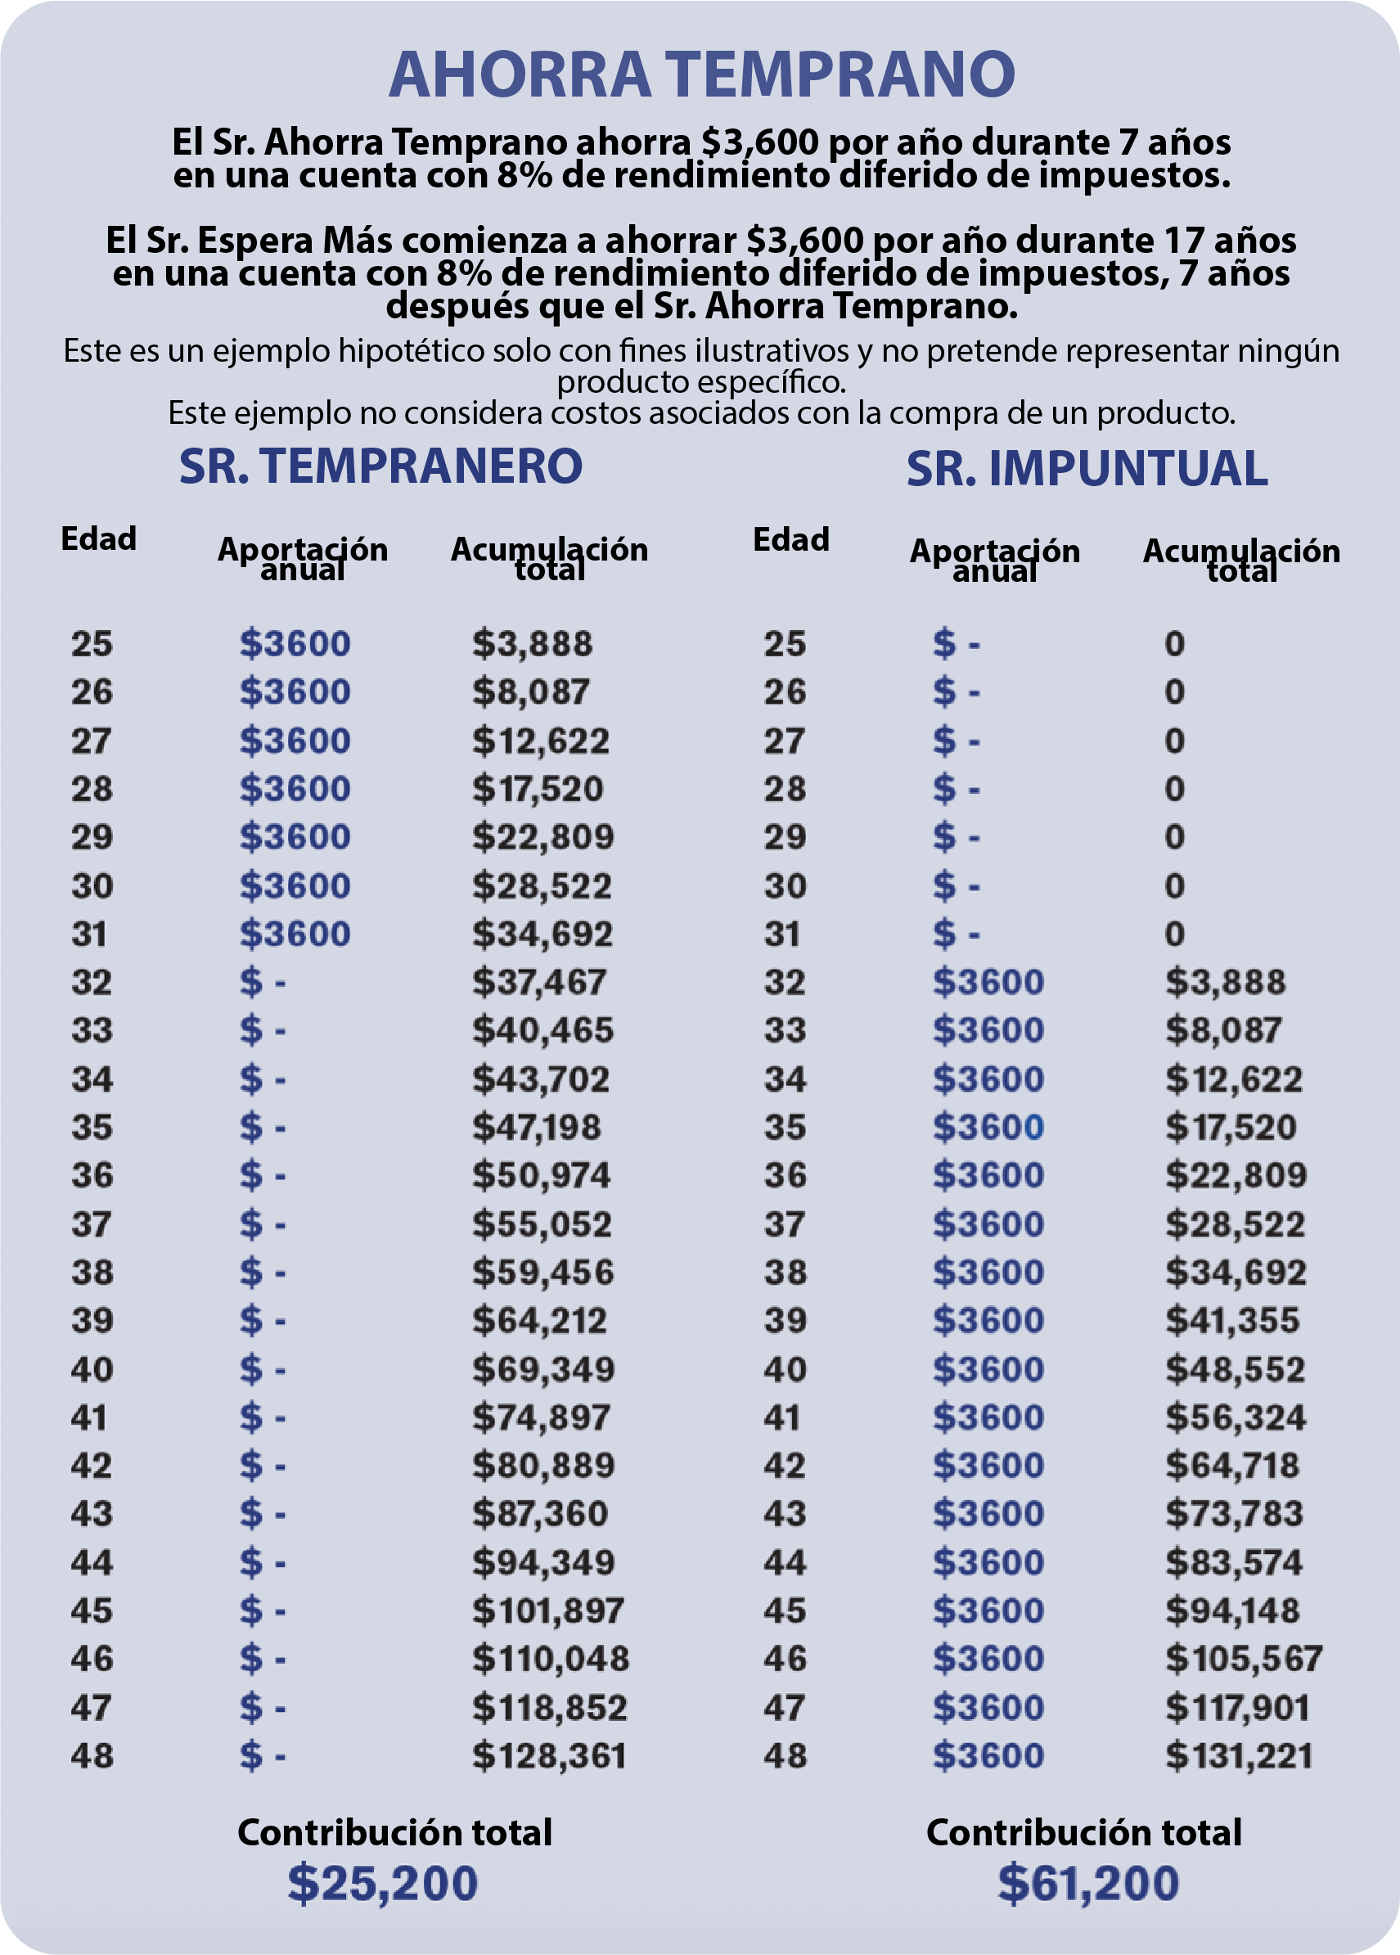
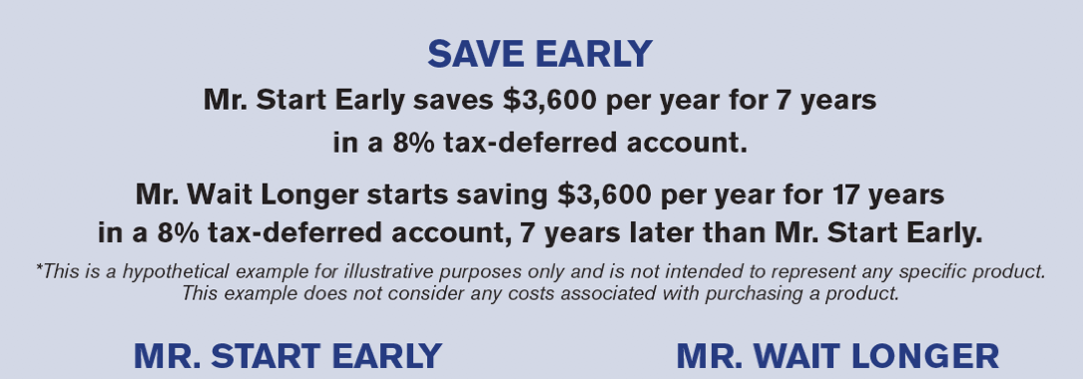
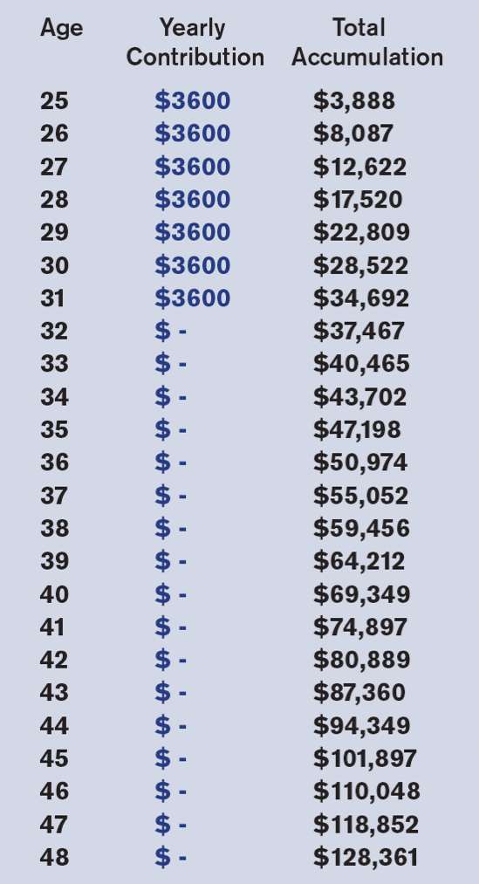
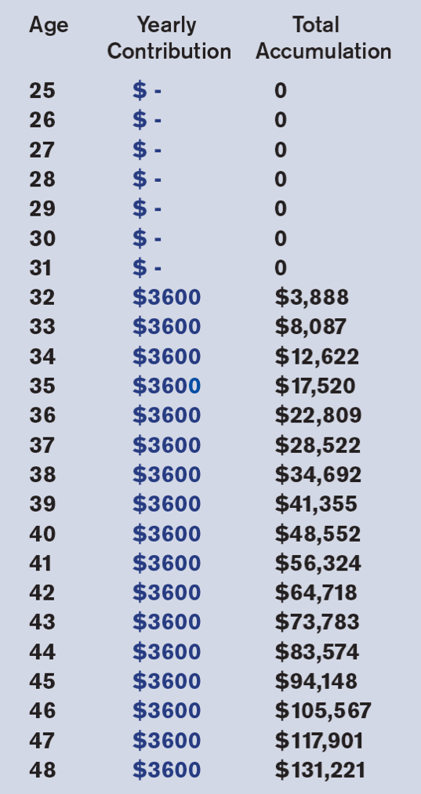


TIEMPO
El tiempo puede estar a nuestro favor o en nuestra contra. Tener mucho tiempo es una ventaja. Pero incluso con el tiempo de nuestro lado, no aprovecharlo puede costarnos. Vea lo que sucede aquí con el Sr. Comienza Temprano y el Sr. Espera Más Tiempo.

Slide 6
LAS 3 REGLAS DEL DINERO
EFECTO COMPUESTO
EFECTO DE RIESGO
EFECTO DE IMPUESTOS
72 / 8 = 9
ÍNDICE
VENTAJA DE IMPUESTOS
Se multiplica cada 9 años
Años
8%
Monto inicial
$10,000
9
$20,000
18
$40,000
ROTH IRA
AHORROS UNIVERSITARIOS 529
BONO EJECUTIVO
CUIDADO A LARGO PLAZO
SEGURO DE VIDA CON VALOR EN EFECTIVO
27
$80,000
36
$160,000
+ SEGURIDAD + CRECIMIENTO
Notes:
Now let’s look more into the Wealth Formula. In the next few sections we’ll be talking about Rate of Return, Inflation and Taxes, and how they can all impact our wealth.
(read slide)
By using the Rule of 72, we can calculate how much an initial principal of $10,000 changes with different interest rates.
By dividing 72 by the rate of return (or interest), equals to the approximate number of years it takes for the money to double.
Note that numbers here are actual values compounded annually. This an example to illustrate a concept and does not represent any specific product.
For example, imagine saving $10,000 in a place with an interest of 6%.
Using the Rule of 72, 72 divided by 6 equals 12, thus every 12 years the money would “double”.
12 years from now, that money would “double” to $20,112.
24 years from now, “double” to $40,489.
36 years from now, “double” to $81,472.
If in a place that grows at 8%, that same $10,000, would now double every 9 years.
From $19,990, 9 years from now, to $39,960 18 years from now.
And 27 years from now, grow to be $79,881.
36 years from now, $159,682.
If in a place that grows at 10%, that same $10,000, would now double every 7.2 years.
7 years from now, ”double” to $19,487.
15 years from now, $41,772.
22 years from now, $81,403.
29 years from now, $158,631.
And finally 36 years from now, $309,126.
So you can see how easy it is to roughly calculate compound interest using the Rule of 72.
Additionally, take a look at year 36, you can see the difference 2% and time makes. The difference between 6% and 8% is two percent, however the resulting amount at age 36 is nearly twice the amount. Also as with 8% and 10%.
Let’s look at an example: if you save $100 and put it into a place that gave you 5% interest, you would have an interest of $5.
Presuming an effective 25% income tax, it would reduce your total by $1.25 giving you a net total of $103.75.
After factoring in inflation (using an average of 3%), you would have an actual return of $100.75. What does this mean?
Do you need around 5% interest to break even on your money? It’s important to understand the real rate of return.

Slide 7
CONSIDERE SUS OPCIONES
3 REGLAS DEL DINERO | 529 PLAN | IUL
COMPUESTO
LIBRE DE RIESGO
LIBRE DE IMPUESTOS
SI
SI
NO
SI
SI
SI
¿Está aprovechando al máximo el lugar donde está invirtiendo?

Slide 8
EFECTOS DE UN PLAN 529
  Aportaciones - Las aportaciones no son deducibles de impuestos a nivel federal.
  Retiros - Si no se utilizan para gastos educativos calificados, los retiros estarán sujetos a impuestos estatales y federales sobre la renta, y a una penalización federal del 10 % sobre las ganancias.
  Ayuda financiera - Invertir en un plan 529 generalmente afectará la elegibilidad del estudiante para recibir ayuda financiera basada en necesidad.
  Efecto de riesgo - Puede crecer con el mercado, pero también puede perder frente al mercado.
Como con cualquier plan, asegúrese de comprender sus restricciones y cómo encaja en su estrategia general.

Slide 9

INDEX UNIVERSAL LIFE
CRECIMIENTO SIN LÍMITE SUPERIOR
SEGURIDAD
0.75%
Crecimiento del mercado
participación del 113%
Garantía de límite inferior para nunca perder
Crecimiento libre de impuestos
Acceso libre de impuestos
Beneficio por fallecimiento libre de impuestos
VENTAJA DE
IMPUESTOS
PROTECCIÓN
Seguro de vida
Protección familiar
Notes:
So we’d like to share with you a concept of understanding a more managed growth strategy.
One that looks at growth, understanding that your rate of return should be high enough to beat taxes and inflation.
Safety – something that helps manage risk and preservation of your principal.
Perhaps that has tax advantages, like tax-deferred growth and tax-advantaged access, which can play a significant role in building wealth.
Lastly, thinking about protection – protect your income, assets and your life. Preparing for the possible need for long-term care, disability, and chronic illness services.
When saving and investing, consider these important factors.

Slide 10
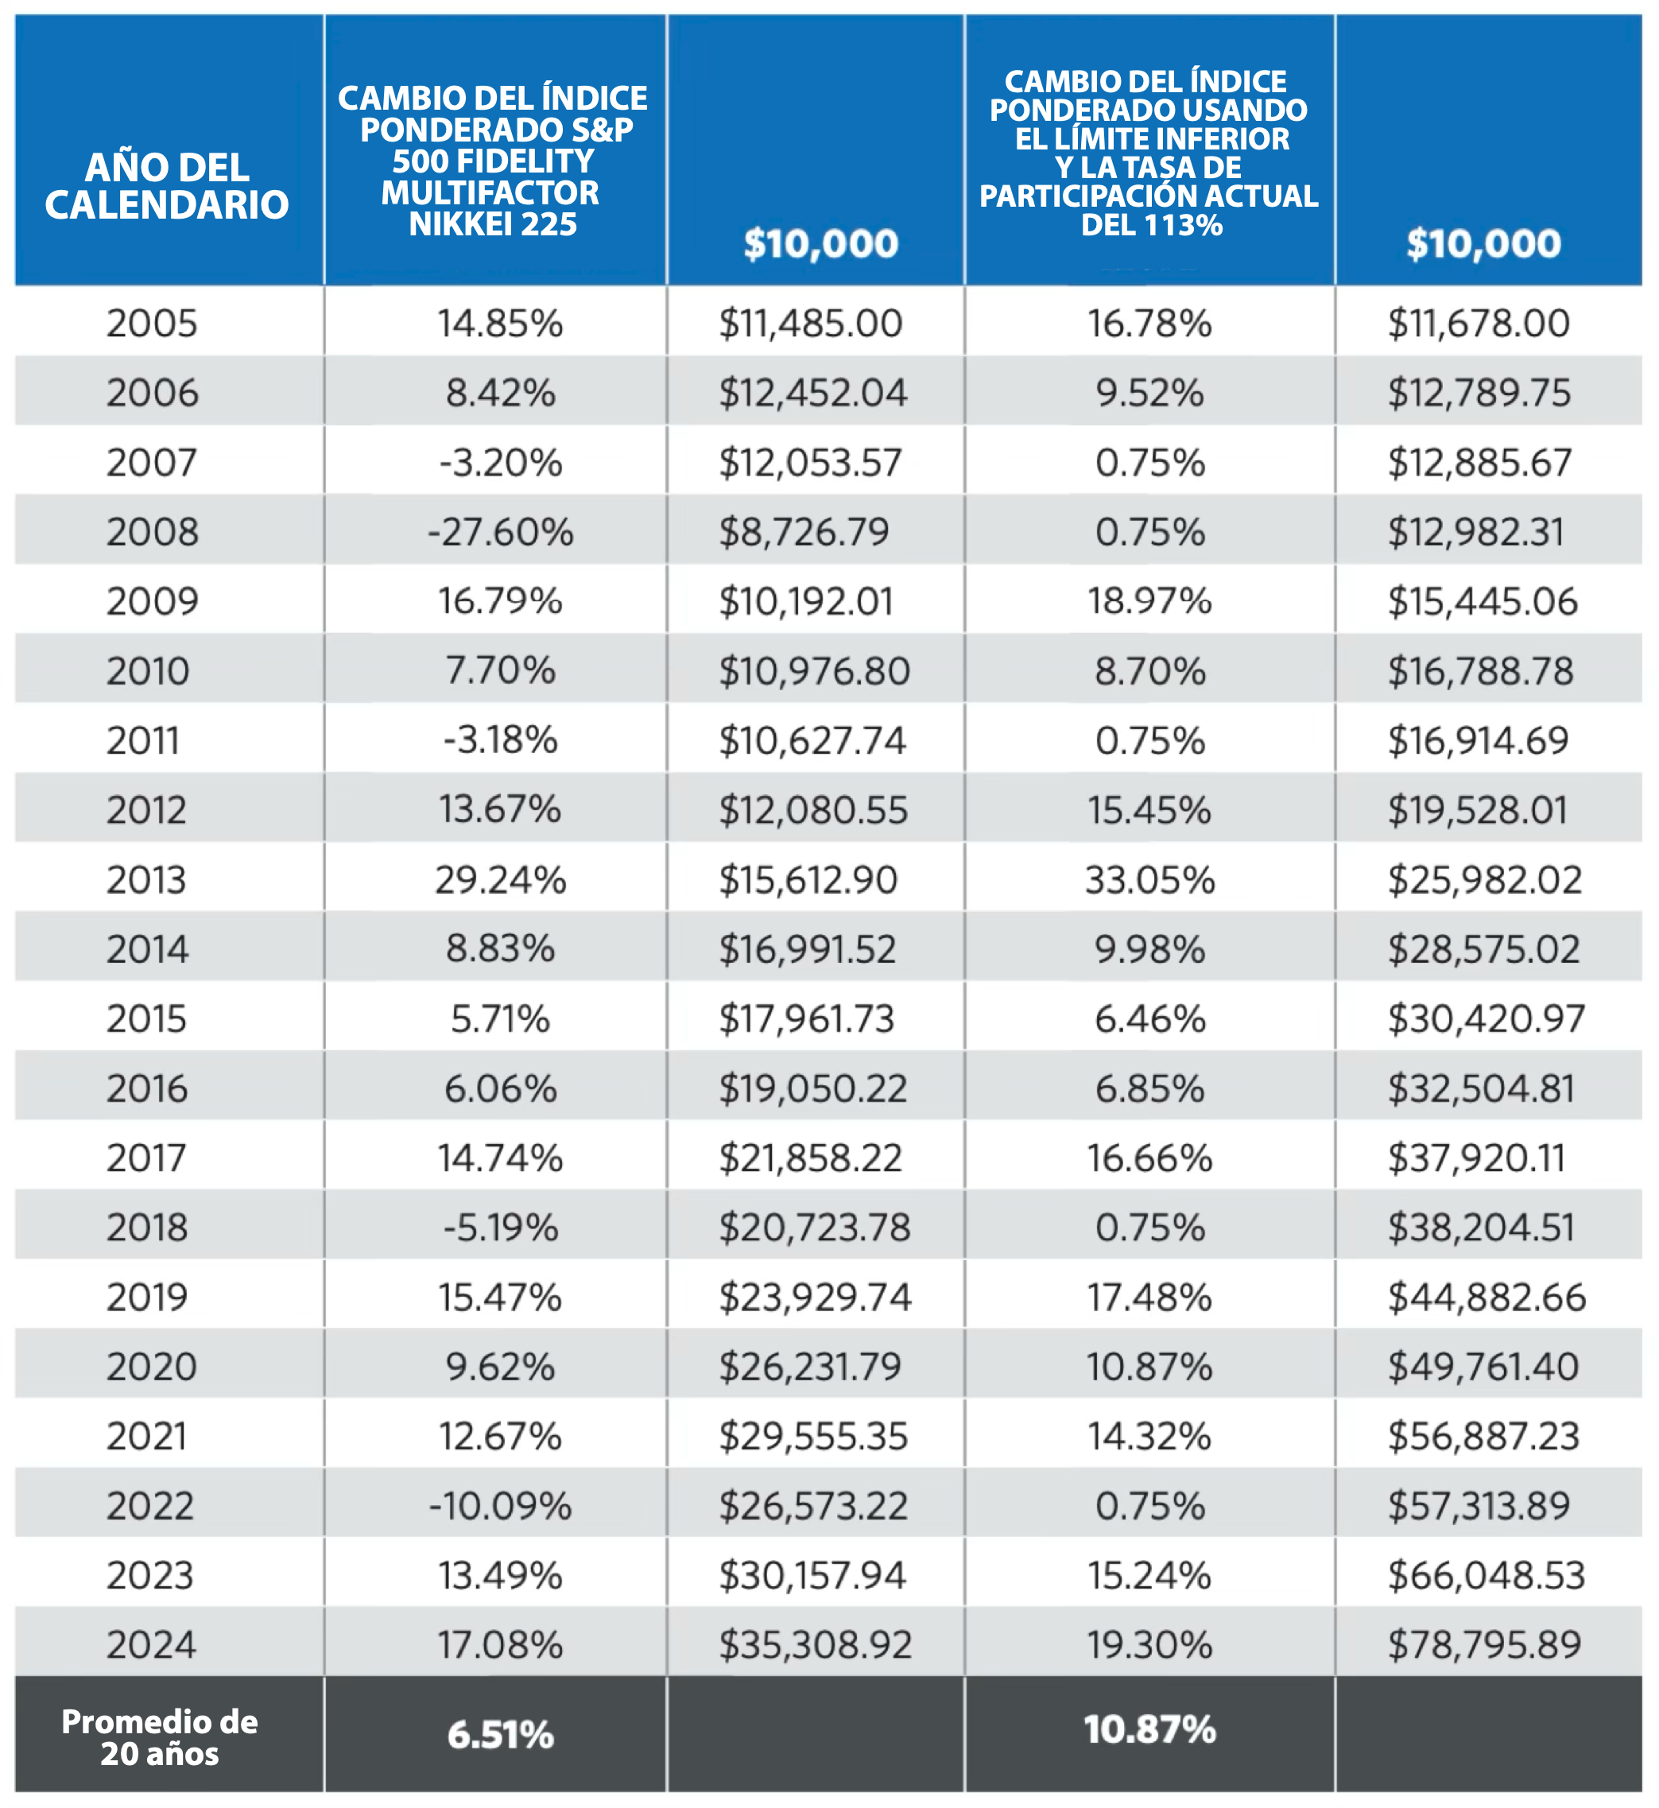

Rendimiento histórico de 20 años
VARIABLE
ÍNDICE
Regla No.1
Nunca perder
Dinero
Regla No. 2
Nunca olvidar la regla No. 1

Slide 11

ILUSTRACIÓN DE SEGURO DE VIDA UNIVERSAL INDEXADO
MILLION DOLLAR BABY

Slide 12
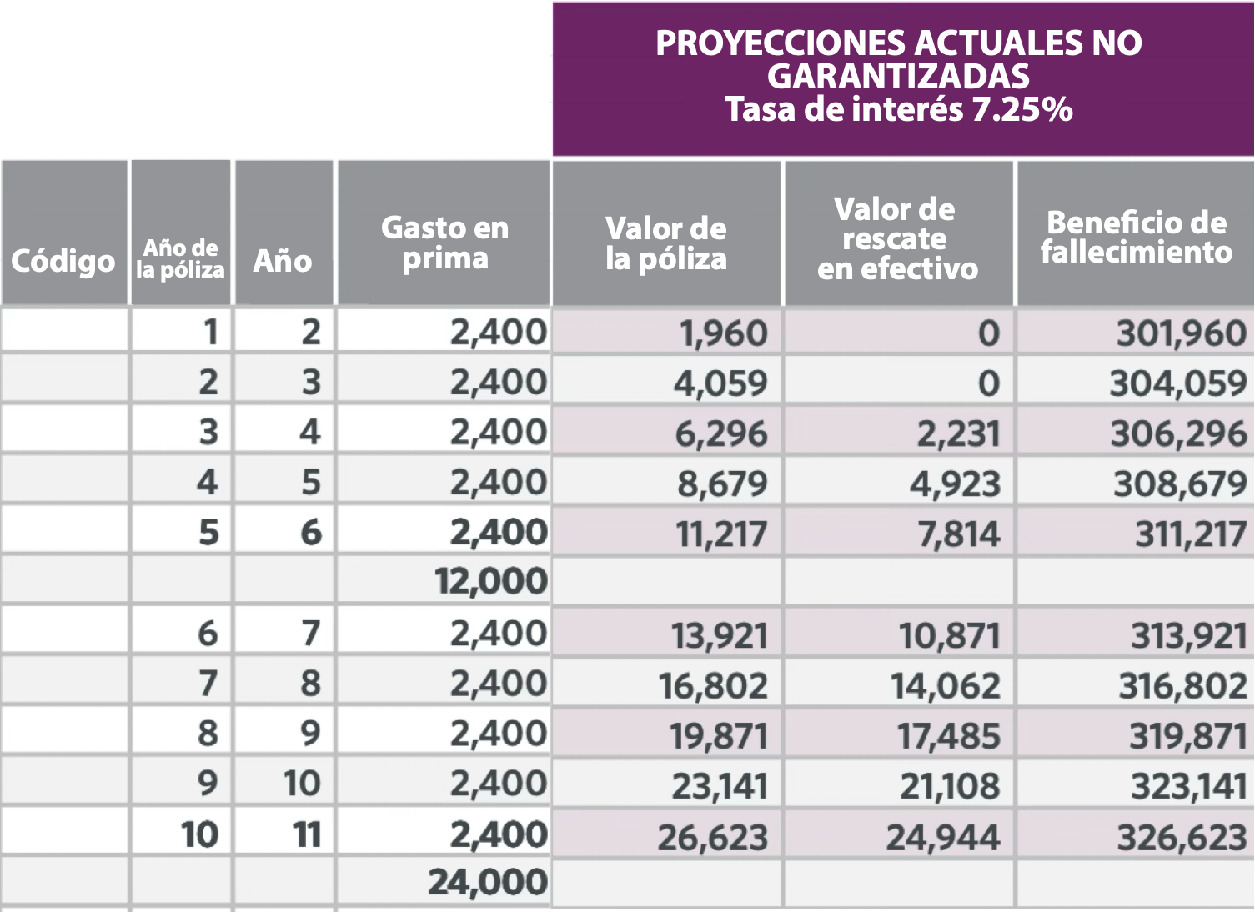
CONOCE A RICKY RICÓN
Ejemplo: Los padres de Richie deciden aportar $200/mes a un IUL para su futuro. Este dinero no se considera un activo incluido y puede usarse para cualquier propósito en cualquier momento. Richie también contará con una protección de $300,000.
This is for illustrative purposes only.

Slide 13
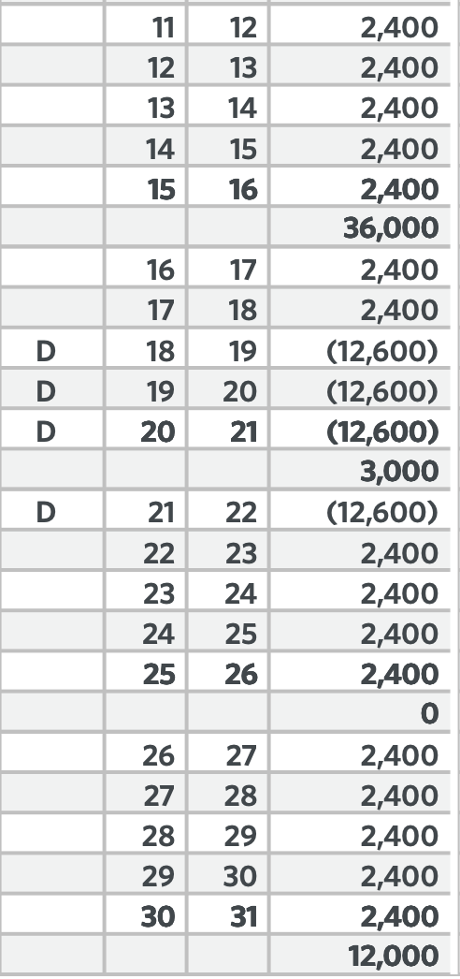
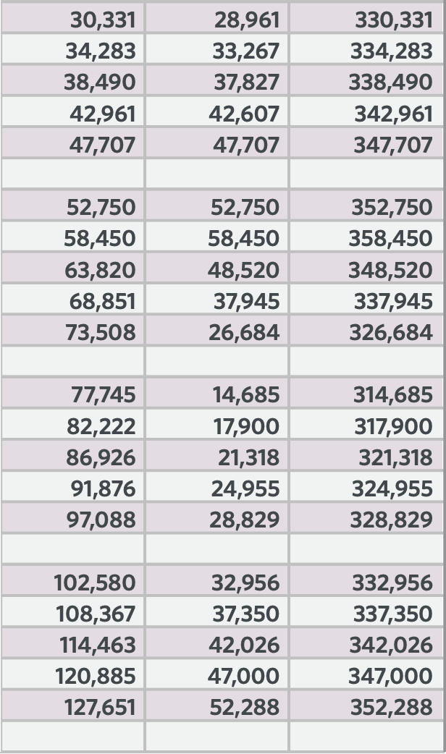
CRECIMIENTO Y ACCESO LIBRES DE IMPUESTOS
$50,000+ fondos destinados
a educación superior.
¡cuanto más ahorras,
más tienes!

Slide 14
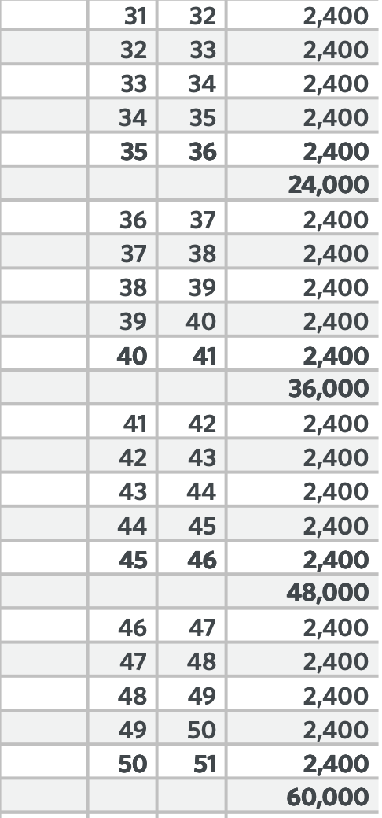
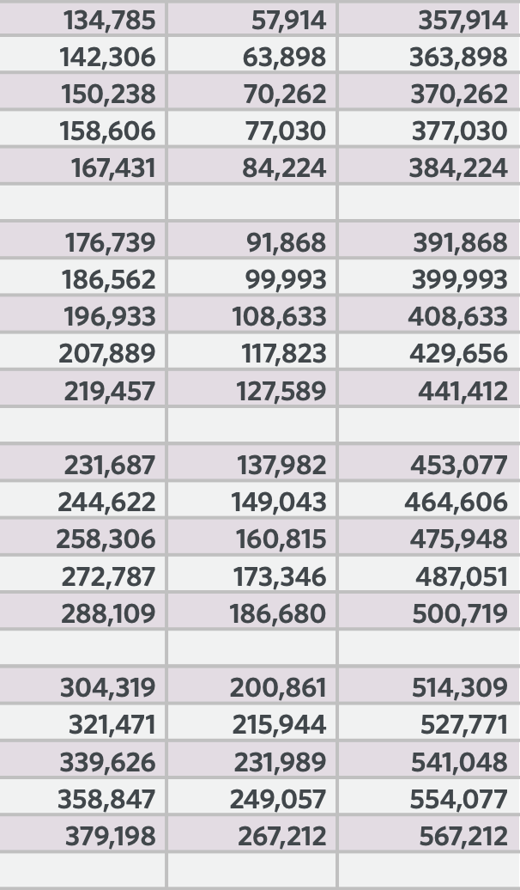
CRECIMIENTO Y ACCESO LIBRES DE IMPUESTOS
Úsalo para el enganche de una casa, un auto, una boda o el inicio de un negocio.

Slide 15
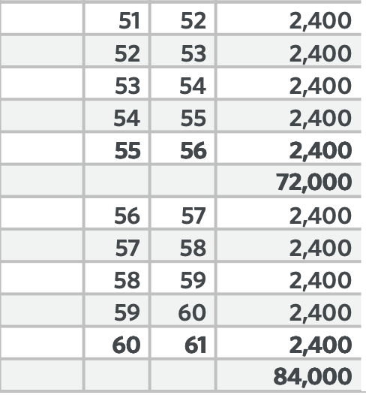
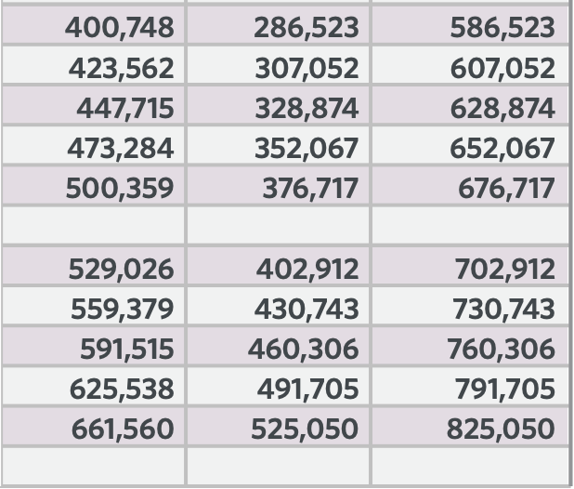
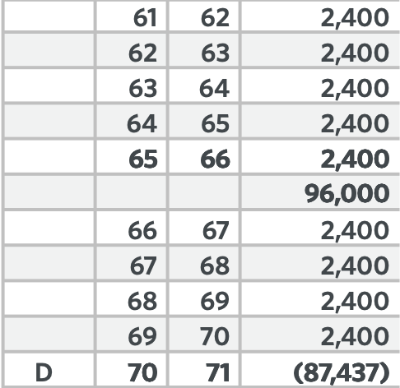
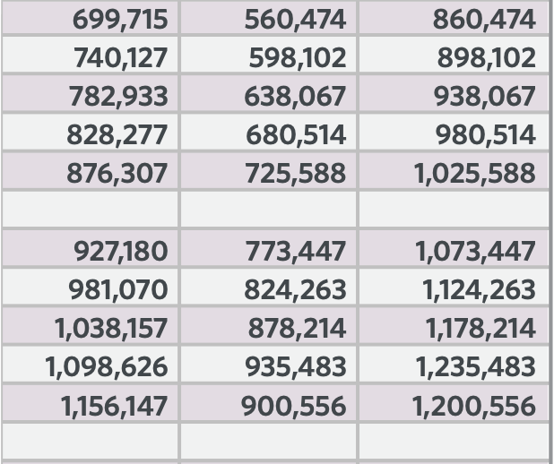
CRECIMIENTO Y ACCESO LIBRES DE IMPUESTOS
Financió la universidad, la vida personal y ahora a la siguiente generación.

Slide 16


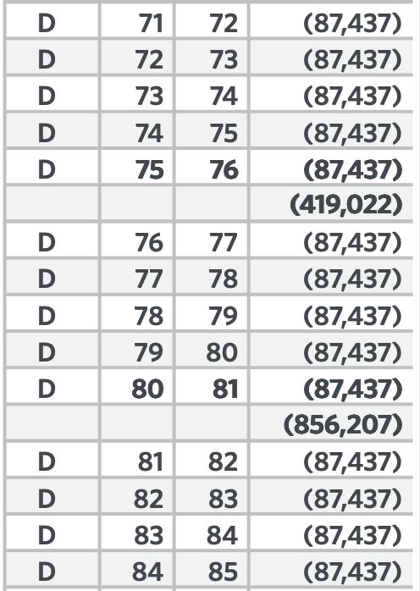
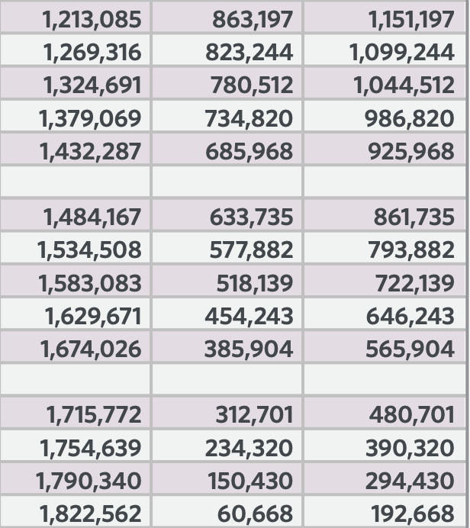
MILLION DOLLAR BABY
$87,437
ingreso libre de impuestos
de 71 a 85 años = $1,311,555

Slide 17















MÁS QUE SOLO AHORROS PARA LA UNIVERSIDAD
Crecimiento compuesto con la tranquilidad de nunca perder dinero
El dinero puede usarse libre de impuestos para cualquier propósito, no solo para la universidad.
No afecta la ayuda financiera, las becas ni los subsidios.
Seguro de vida permanente y protección que conservarán para siempre.
Notes:
So we’d like to share with you a concept of understanding a more managed growth strategy.
One that looks at growth, understanding that your rate of return should be high enough to beat taxes and inflation.
Safety – something that helps manage risk and preservation of your principal.
Perhaps that has tax advantages, like tax-deferred growth and tax-advantaged access, which can play a significant role in building wealth.
Lastly, thinking about protection – protect your income, assets and your life. Preparing for the possible need for long-term care, disability, and chronic illness services.
When saving and investing, consider these important factors.

Slide 18

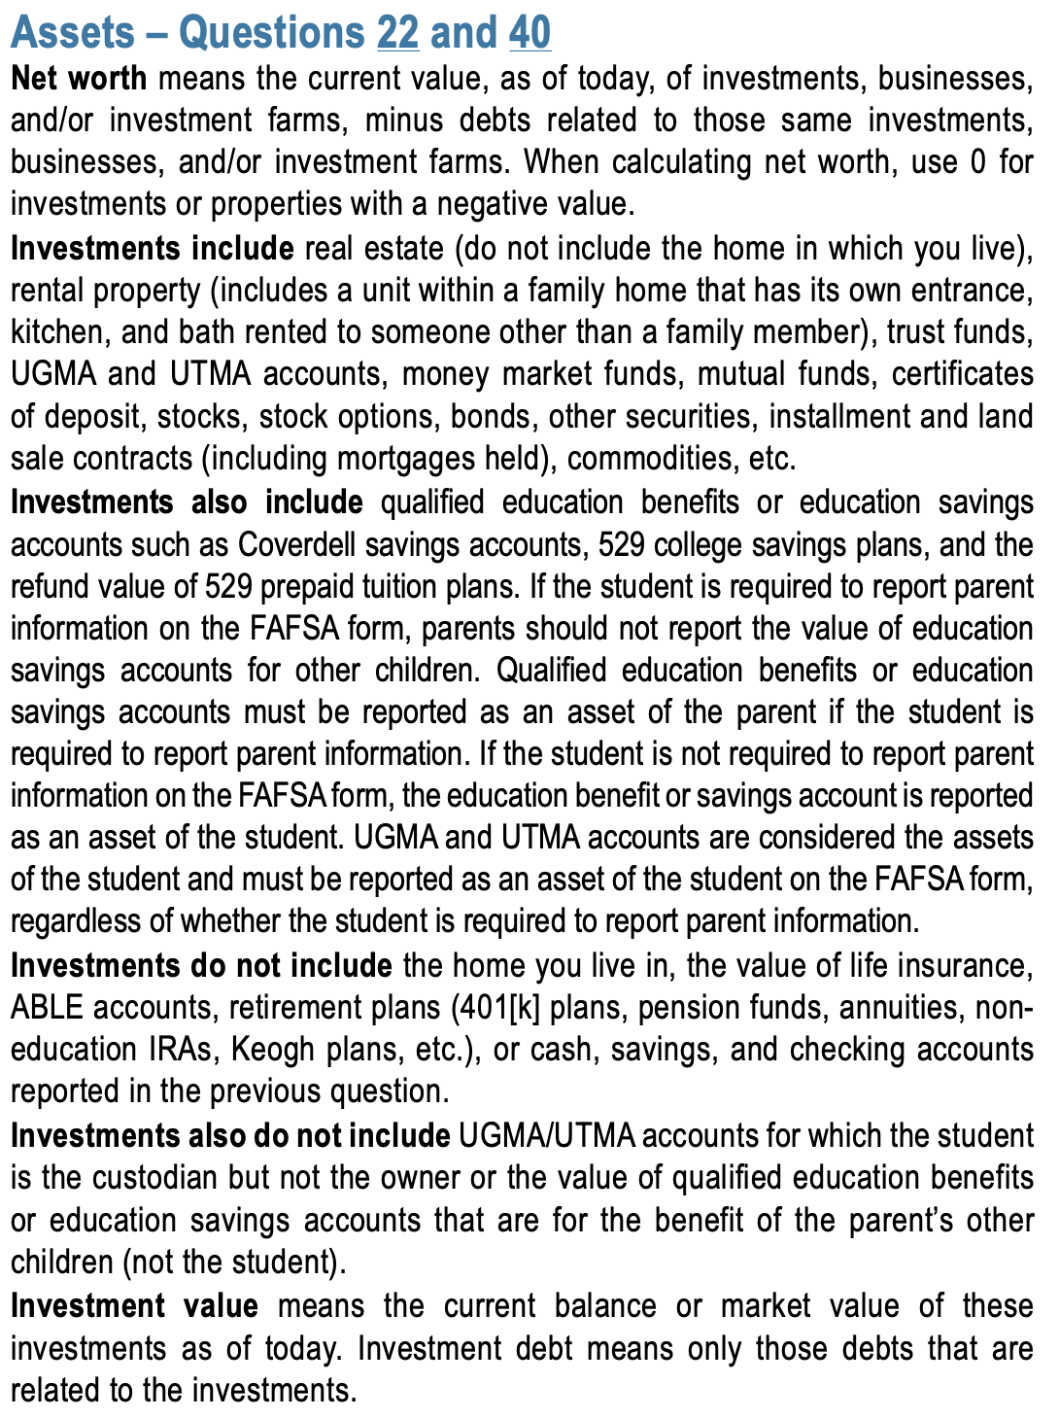
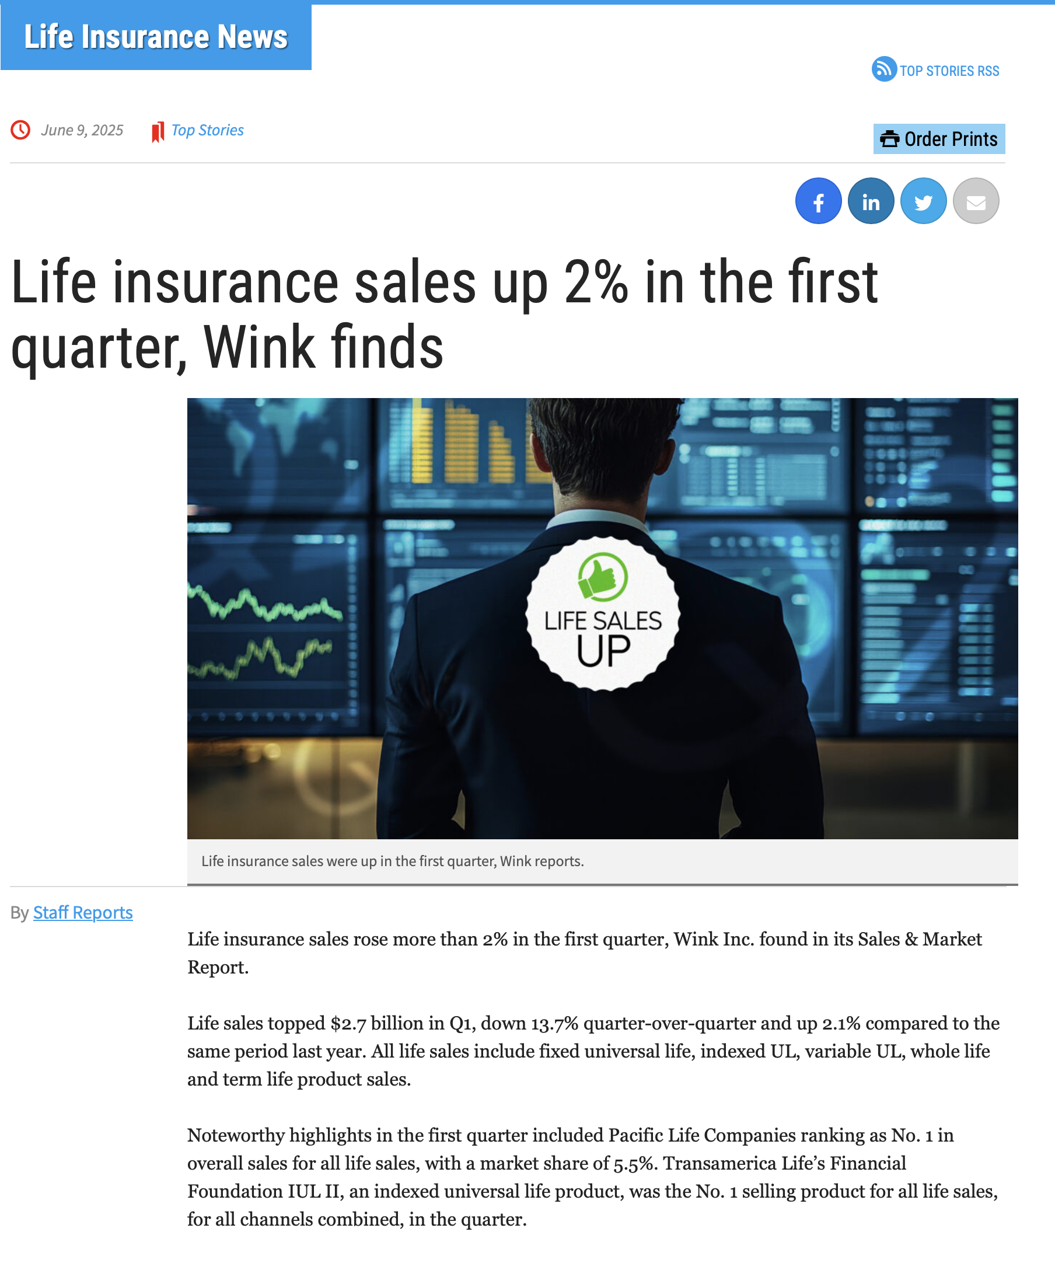

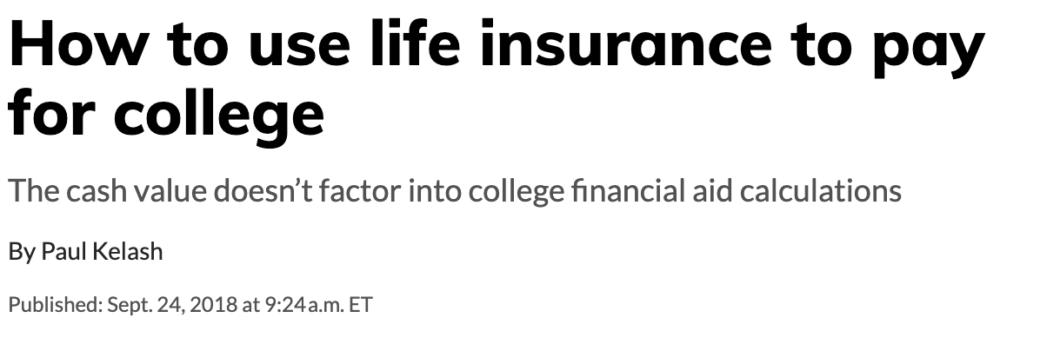
UNA ESTRATEGIA REVOLUCIONARIA
Notes:
So we’d like to share with you a concept of understanding a more managed growth strategy.
One that looks at growth, understanding that your rate of return should be high enough to beat taxes and inflation.
Safety – something that helps manage risk and preservation of your principal.
Perhaps that has tax advantages, like tax-deferred growth and tax-advantaged access, which can play a significant role in building wealth.
Lastly, thinking about protection – protect your income, assets and your life. Preparing for the possible need for long-term care, disability, and chronic illness services.
When saving and investing, consider these important factors.

Slide 19



EL NUEVO ARTE
DE VIVIR
SIGUIENTE PASO
PLANEE EL FUTURO DE SUS HIJOS
DESCUBRA SUS AHORROS
PÁGUELE A SU FAMILIA PRIMERO
PERSONALICE SU ESTRATEGIA
APLIQUE LAS 3 REGLAS DEL DINERO
APLIQUE Y CALIFIQUE
EL TIEMPO ES SU MÁS GRANDE ACTIVO - CUMPLA LAS 3 METAS

